Slide 1

UNIVERSITY INSTITUTE OF ENGINEERING
COMPUTER SCIENCE ENGINEERING
Bachelor of Engineering (Computer Science & Engineering)
Subject Name: Big Data Analytics
Subject Code: 20CST-471
Introduction to big data
Mapped with CO1
Prepared By:
Er. Ankita Sharma
DISCOVER . LEARN . EMPOWER

Slide 2
Introduction to big data
Big Data Analytics is a transformative process that involves extracting valuable insights from vast and complex datasets, commonly referred to as "big data."
In the contemporary data landscape, organizations accumulate information from diverse sources, such as social media, sensors, and transaction records. The challenges posed by the sheer volume, velocity, variety, and veracity of this data necessitate advanced analytics approaches.

Slide 3
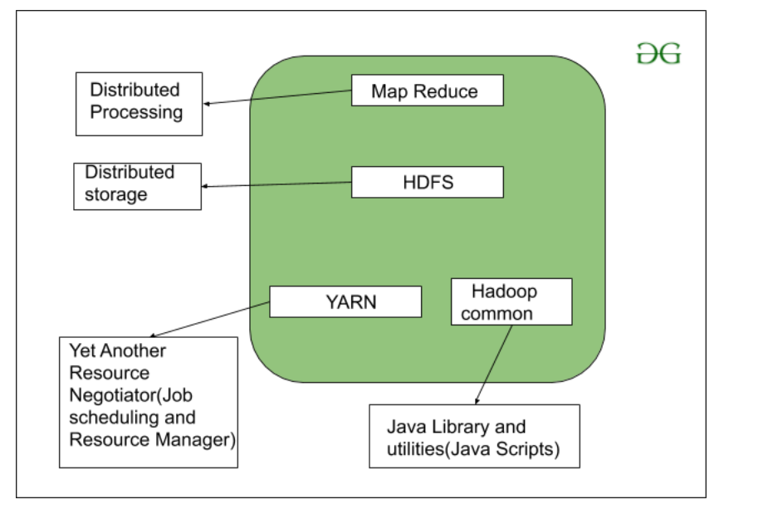
Introduction
Key components of Big Data Analytics include,
data collection, storage, processing, and the use of analytics tools and machine learning algorithms. Technologies like Apache Hadoop and Apache Spark are instrumental in handling the distributed processing requirements of big data.

Slide 4
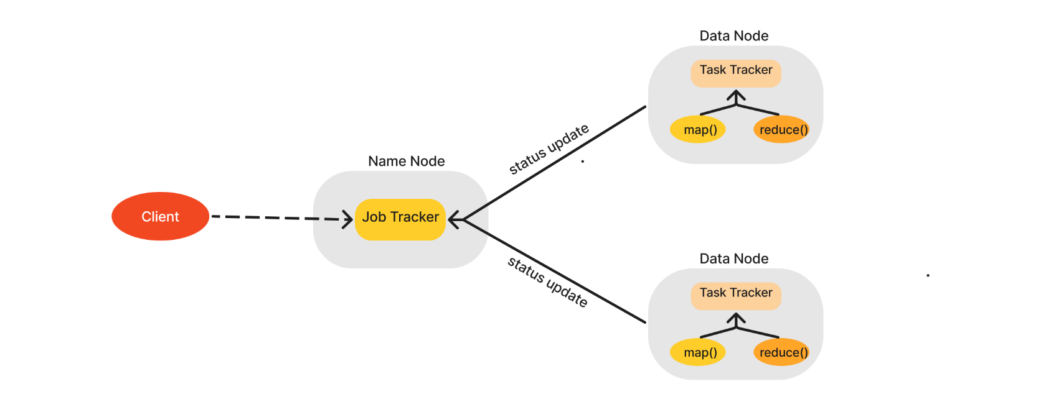
Data visualization tools further facilitate the communication of complex insights to decision-makers, aiding in effective decision-making. Despite challenges such as data quality and varying formats, the potential benefits of big data analytics span across industries, driving innovation, optimizing processes, and enhancing overall business strategies.

Slide 5
Moreover, the field of Big Data Analytics plays a pivotal role in addressing the dynamic nature of today's data environment.
The high velocity at which data is generated, particularly from real-time sources, underscores the importance of processing and analyzing information promptly.
As organizations grapple with massive data volumes, distributed storage systems like the Hadoop Distributed File System (HDFS) and cloud-based solutions have become instrumental in managing and storing this wealth of information.

Slide 6
The inclusion of machine learning algorithms is another critical facet of Big Data Analytics. These algorithms enable predictive modeling, classification, clustering, and anomaly detection, empowering organizations to unearth patterns and trends that might otherwise remain hidden.
The application of machine learning enhances the ability to make data-driven predictions and recommendations, thereby influencing strategic decision-making processes.

Slide 7
Despite the undeniable potential of Big Data Analytics, several challenges persist.
The diverse nature of data types—ranging from structured to unstructured—requires flexible tools and strategies.
Ensuring the accuracy and reliability of the data, known as veracity, is an ongoing concern that demands meticulous attention.
Organizations also strive to derive tangible value from their analytics efforts, necessitating a focus on actionable insights that lead to tangible business improvements.

Slide 8
In conclusion, Big Data Analytics continues to shape the landscape of data-driven decision-making across industries.
The evolving technologies, coupled with the innovative use of analytics tools, contribute to the ongoing growth and relevance of this field.
As organizations navigate the complexities of big data, the ability to harness insights effectively becomes a strategic imperative, positioning them to adapt, innovate, and thrive in an increasingly data-centric world.

Slide 9
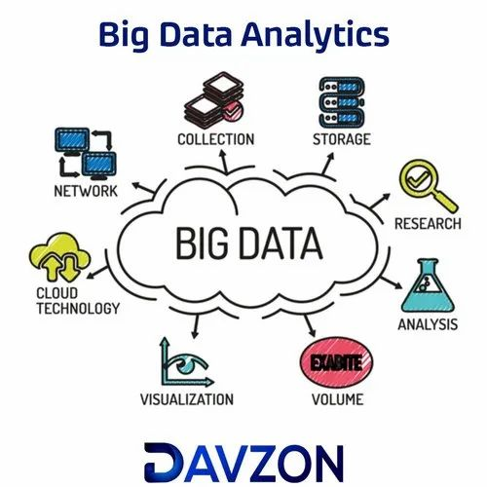

Slide 10
THANKYOU

